Slide 1

CAPSTONE PROJECT
Customer Complaints Classification
08 NOV 2021
Nadun Basnayake

Slide 2
BIO
Nadun Basnayake
Education:
BSc in IT, MBA, Data Science
Skills:
SQL, Python, Machine Learning, Deep Learning
Work:
SQL Programmer

Slide 3
Business Question
How can we use Customer Complaints Classification to improve customer service?

Slide 4
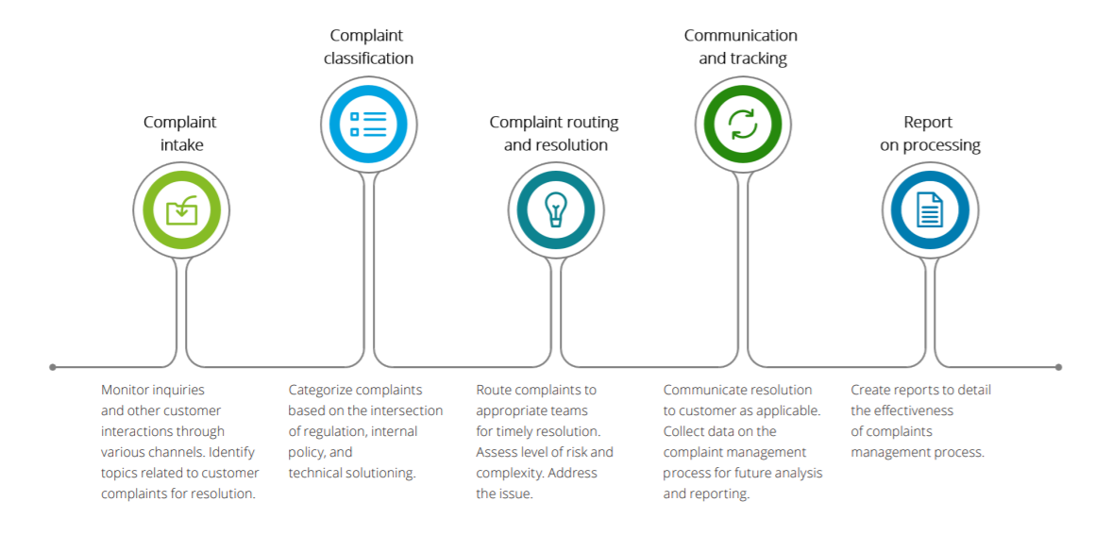
Importance of the Question
Companies have to handle high volumes of complaints through a wide range of channels – from fax to chat bots.
Companies that adapt well to new technologies (i.e AI / NLP) have a higher chance of retaining customers.
Ability to apply to other areas of business, other media (chats, calls)
Sample Customer Complaint Management Lifecycle

Slide 5
Pipeline
Data
Acquisition + Business Question
Exploring & Cleaning
Delivery
Modelling
Tuning & Validate
NLP
Techniques

Slide 6

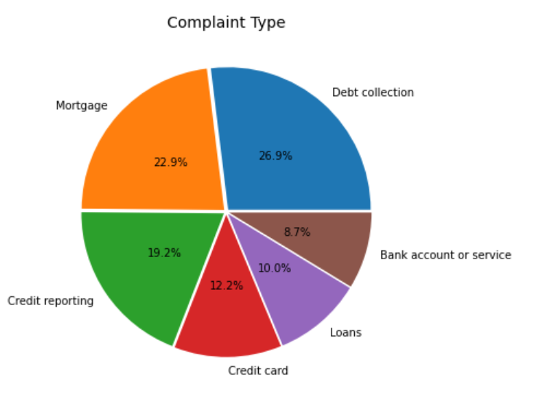
Dataset Summary
US Consumer Complaints Dataset taken from Kaggle
Data of Financial Services – data from over 2000 companies
64989 data rows with complaints once cleaned - used for modelling
556K total rows – some used for EDA
Complaints Text data used for modelling & other features analyzed
Target Variable: Complaint Type (Multi-class Text Label)
Consumer Complaint Database
https://www.kaggle.com/kaggle/us-consumer-finance-complaints
https://www.consumerfinance.gov/data-research/consumer-complaints/

Slide 7
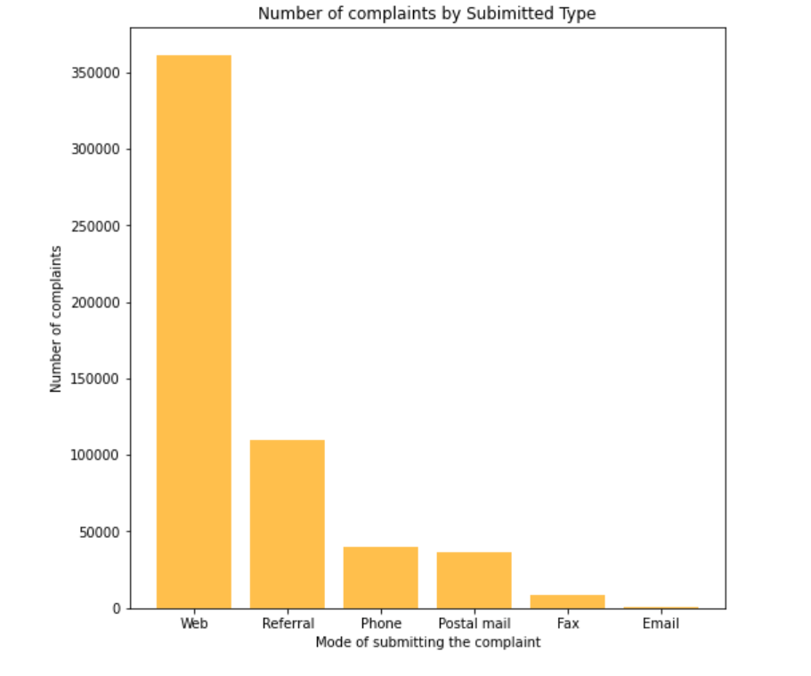
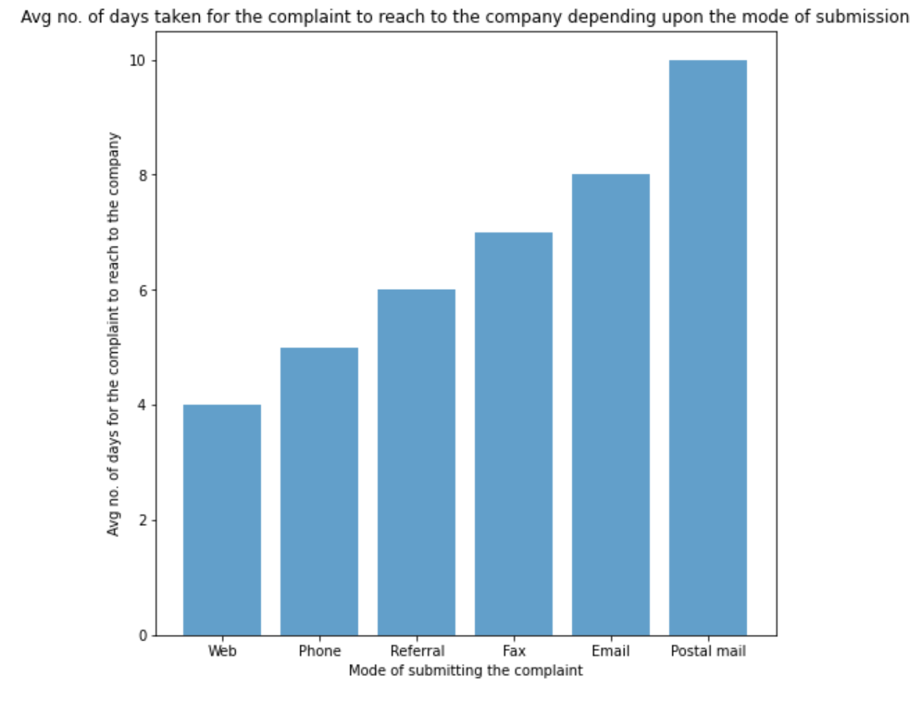
EDA
Only “Web” type contains a complaint text. Not all “Web” responses have text

Slide 8
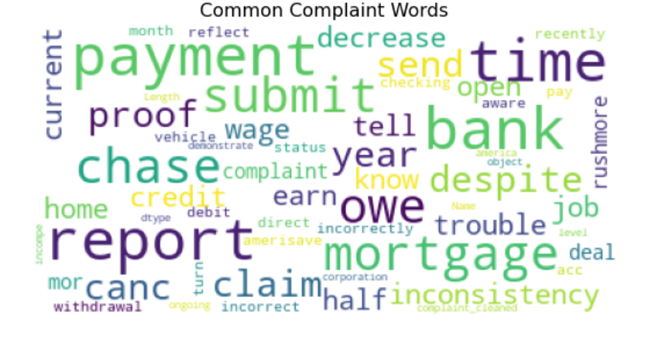
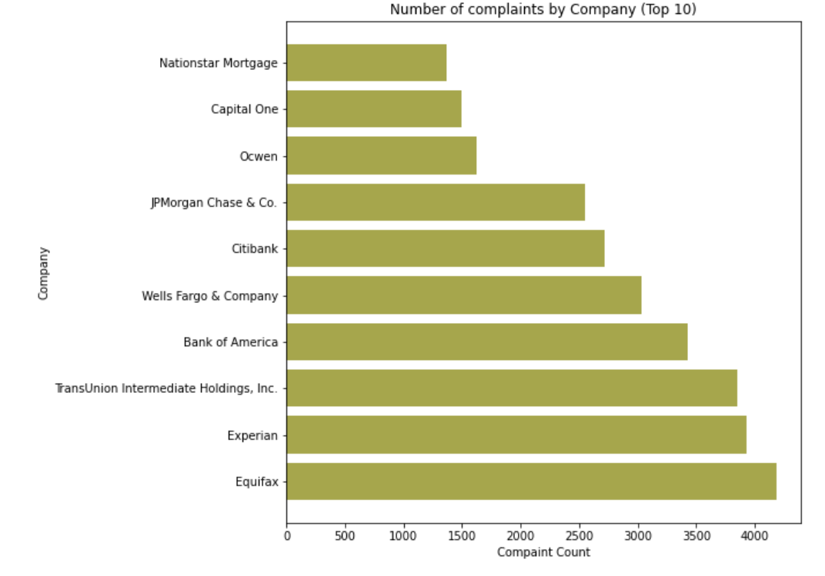
EDA

Slide 9
Processing & Modelling
Vectorized (Count, TF-IDF, N-Gram)
Removed Punctuations, Stop Words, Lemmatized
Modelling
Multinomial Naïve Bayes
Support Vector Machine
Random Forest
Gradient Boosting
XG Boost
LSTM - Recurrent Neural Network
1D Convolutional Neural Network
Topic Modelling
Sentiment Analysis
Emotion Detection
Text Summarization
Additional Modelling on Company Response Messages
XG Boost

Slide 10
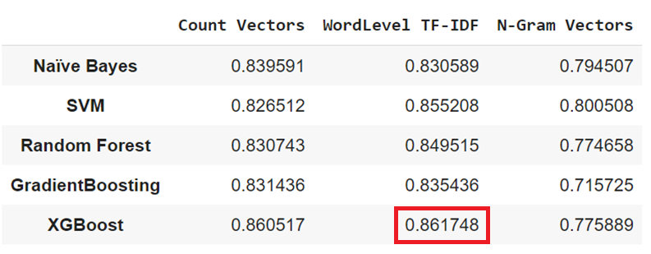
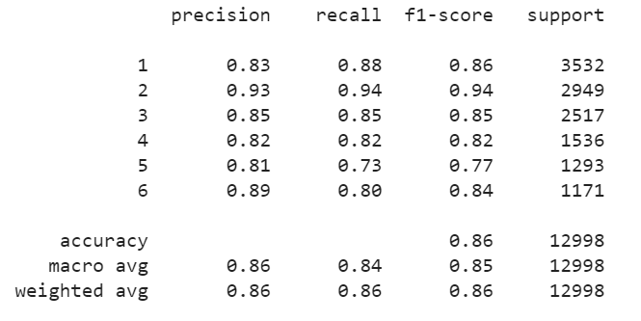
Accuracy
XGB
Best Performing: XGB on Word-level TF-IDF

Slide 11
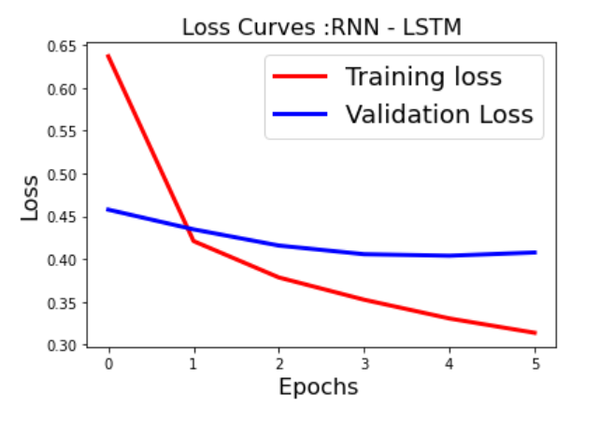
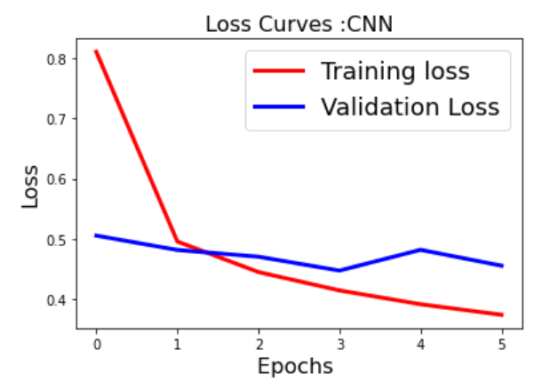
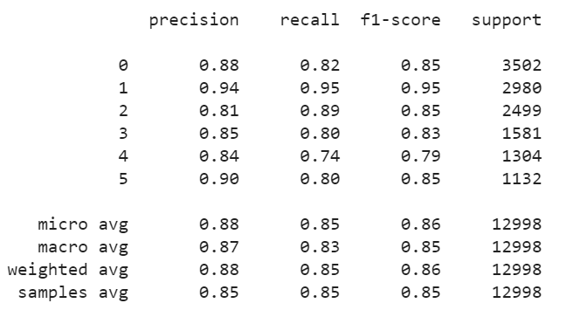
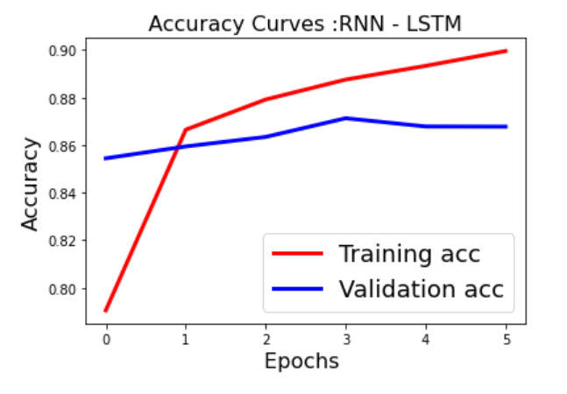
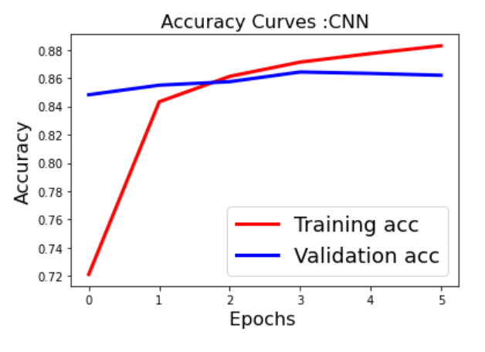
Accuracy – Neural Networks
RNN : 0.8541
CNN : 0.8514
RNN

Slide 12
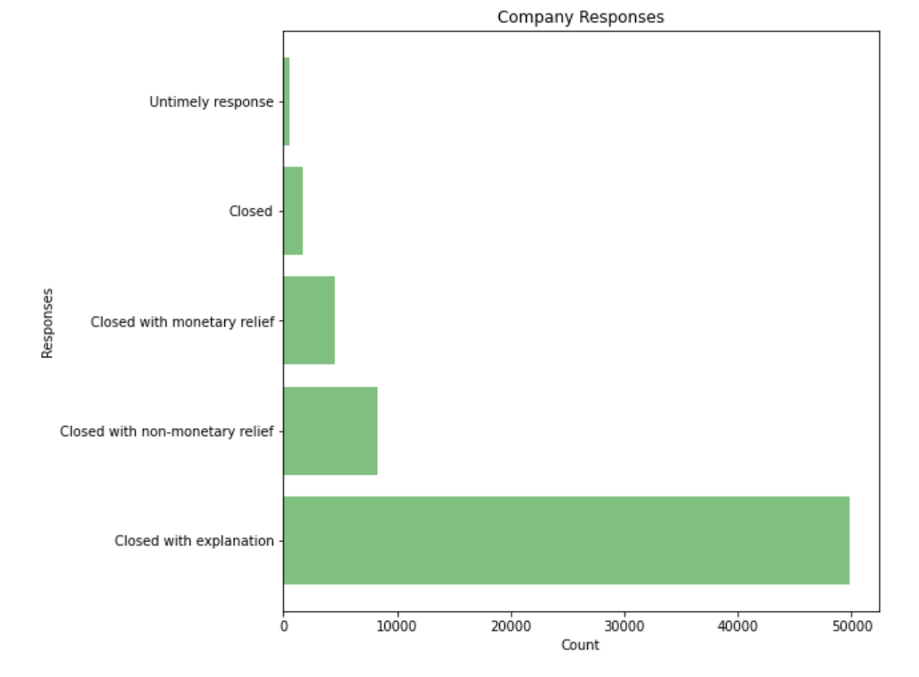
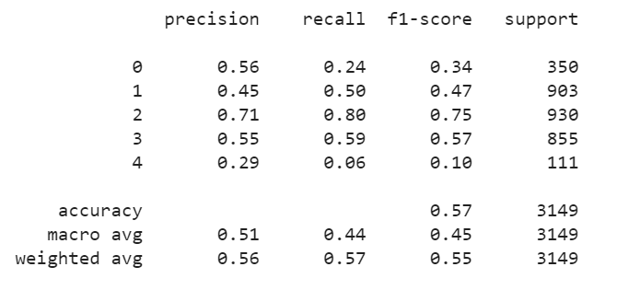
Extra Modelling (Demo)
Can we predict complaints that cost money?
XGB

Slide 13
Topic Modelling
Modelled on the entire Dataset with no labels

Slide 14
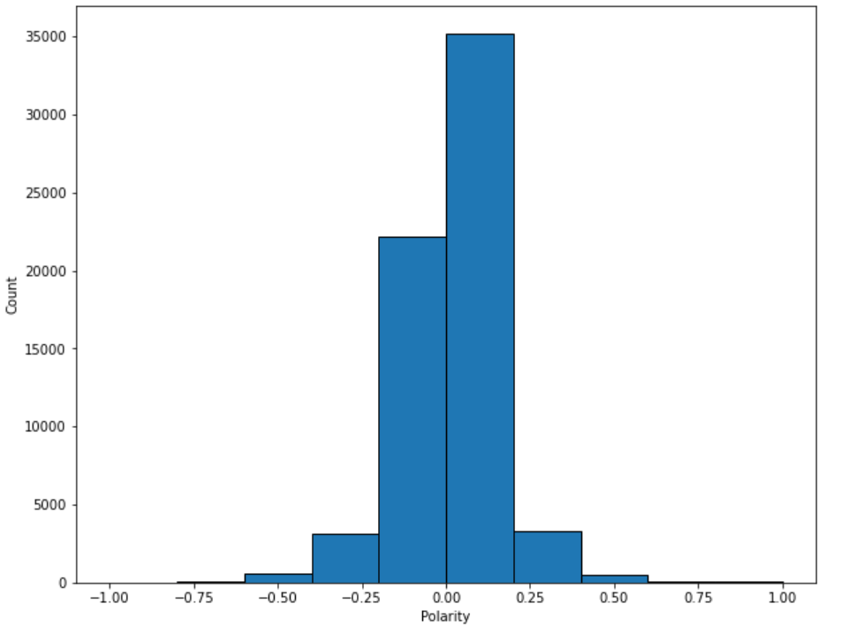
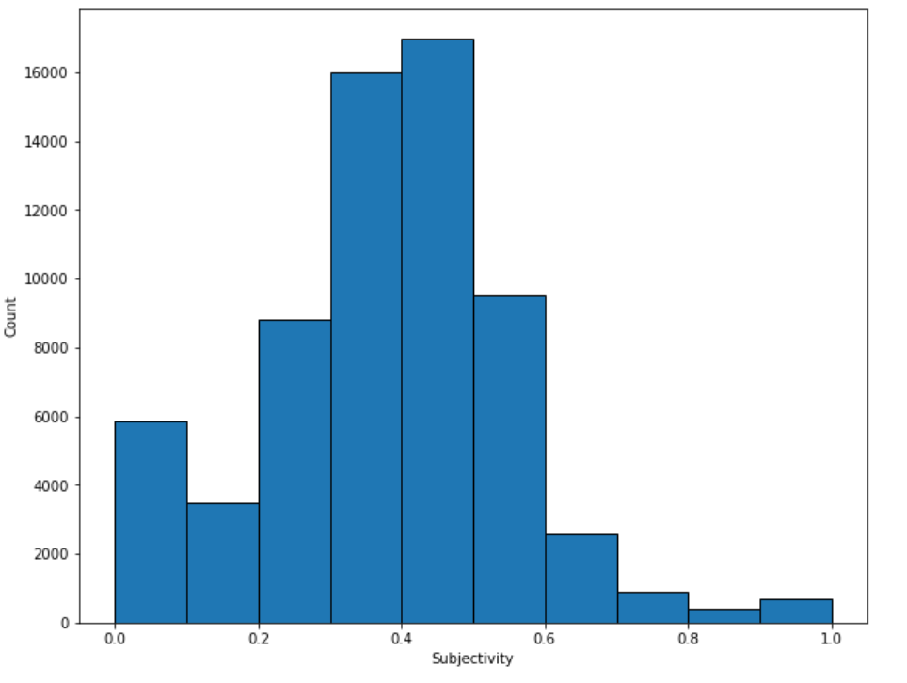
Sentiment Analysis
Polarity is float which lies in the Range [-1 = Negative, 1 = Positive]
Subjective sentences refer to personal opinion, emotion or judgment whereas objective refers to factual information. Range: [0,1]

Slide 15
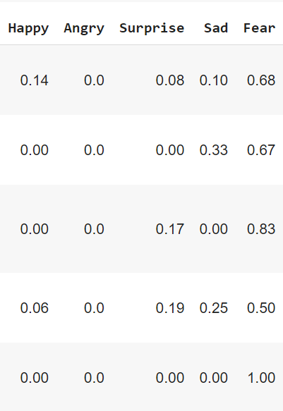
Emotion Detection
😁 😡 😲 😢 😧
Analyzed using text2emotion
Most of the complains detected “Fear” emotion (~ 70 %)
Not recommended for customer complaints analysis

Slide 16
Text Summarization
Analyzed using 4 algorithms on Sumy library (extractive summarization)
SAMPLE: I recently became aware that Amerisave Mortgage Corporation participated in some illegal practices that harm customers. I did not know at the time ( until recently ) that I had any legal recourse for an issue I had, and I would like to seek restitution at this time. I applied for a 30 year fixed rate mortgage loan with Amerisave on XXXX/XXXX/06 ( loan application # XXXX ). As part of the process I paid for an appraisal. I also paid for " discount points \'\' to lower the interest rate on the mortgage. These payments were made through my credit card on XXXX/XXXX/06, and I have those records. Shortly after I cancelled the loan, as the terms had not been satisfactory. It was my understanding that the {$390.00} appraisal fee was non-refundable, but the {$3000.00} that was paid in discount points should have been reimbursed. I inquired many times to Amerisave to get this {$3000.00} reimbursement and they said they could not refund the money. Not only was this bad customer service, but caused customer harm to me in a deceptive and possibly illegal action of not returning the {$3000.00} in funds. Although it has been nearly 10 years, I would like to have this money refunded to me. I did not know at the time that I had any rights to get this money back, and was told to the contrary. Please advise. Thank you.
SUMMARIZED (Lex Rank / LsaSummarizer):
It was my understanding that the {$390.00} appraisal fee was non-refundable, but the {$3000.00} that was paid in discount points should have been reimbursed. I did not know at the time that I had any rights to get this money back, and was told to the contrary.
SUMMARIZED (Text Rank / LuhnSummarizer):
I did not know at the time ( until recently ) that I had any legal recourse for an issue I had, and I would like to seek restitution at this time. I did not know at the time that I had any rights to get this money back, and was told to the contrary.

Slide 17
Findings Summary & Discussion
We can predict customer complaints category with an accuracy upto 86%
Modelling can be used to direct customers to provide a better service – reducing delays, identifying the problem correctly
Best performing model: XGBoost
Using Term-Frequency at word level yields the best results.
Additional feature columns used did not contain enough data for further meaningful modelling although it helped understand the problem better.
Text Summarization helps as an additional step when we have longer texts – does not work well on shorter text.
Emotion detection on text does not return meaningful results on complaints data
Topic modelling can also be used to categorize when labelled data are unavailable – this needs to be combined with domain expertise.
Sentiment analysis helps distinguish between customer dissatisfaction and a formal complaint – majority of the complaints are formal complaints.
Next Steps: Deployment of the model on Azure / AWS

Slide 18
Solution & Next Steps
Deployed ML Solution
Web
Text Data
Email
Classification + Text Summarization
Request
Web
System
Referral
Extract Text
(Image to Text)
Postal Mail
Fax
Customer Issue
directed to the relevant department
Phone

Slide 19
Questions?
Thank you!

